Slide 1
GIS Interventions in the Punjab – A Critical Review
COUNTRY PAPER BY SAI PAKISTAN
28TH intoSAI WGITA MEETING, NADI ,FIJI

Slide 2
Abbreviations
ADB | Asian Development Bank
BHU | Basic Health Unit
CMAP | Crime mapping & analysis program
CNIC | Computerized National Identity Card
DG | Director General
DGPS | Differential Global Positioning System
DMS | Disaster Management System
DWIWG | Digital Geographic Information Working Group
EPI | Expanded Programme on Immunisation
FERRP | Flood Emergency Reconstruction & Resilience Project
GIS | Geographic Information Systems
ICT | Information and Communication Technology
iLRMIS | Integrated Land Record Information System
ISOR | International organization of Scientific Research
ISSN | International Standard Serial Number
IT | Information Technology
KPRRP | Khadim-e Punjab Rural Roads Program

Slide 3
Abbreviations
MAPS | Mapping and Analysis for Public Safety Program
NATO | North Atlantic Treaty Organization
NDA | Non-Disclosure Agreement
NSDI | National Spatial Data Infrastructure
OGC | Open GIS consortium
PDMA | Punjab Disaster Management Authority
PITB | Punjab Information Technology Board
PPMRP | Punjab Public Management Reforms Program
SDI | Spatial Data Infrastructure
SDTS | Spatial Data Transfer Standards
SUPARCO | Pakistan Space and Upper Atmosphere Research Commission
TB | Tuberculosis
UC | Union Councils
UIPT | Urban immovable property tax

Slide 4
Sequence Of Presentation
Introduction
Statement of the problem
Scope of the study
GIS concepts
GIS in the Punjab

Slide 5
Sequence Of Presentation …Contd..
Analysis of selected GIS projects
Overall Critical Review of GIS implementation
Conclusion
Recommendations

Slide 6
Introduction
GIS represents a modern-era manifestation of the impact Information Technology (IT) has made in various public and private sector operations
By digitizing the basic spatial information of an area, GIS has enabled an integrated real-time data-driven approach to government operations

Slide 7
Introduction… Contd…
In Pakistan GIS has made foot prints as well
In recent years the provincial government of the Punjab has undertaken various GIS projects to modernize and enhance its service delivery
This paper looks to analyze such initiatives

Slide 8
Statement Of The Problem
How and to what extent the government of the Punjab has undertaken GIS interventions?
Have the GIS solutions increased efficiency and significantly modernized the erstwhile traditional working to the target government offices? and
Have GIS interventions added value to the government services?

Slide 9
Scope Of The Study
“Over-view” of GIS implementations in the province of Punjab only.
Detail analysis of two GIS interventions in the Punjab.
Broad assessment of the potential avenues for future GIS implementation.

Slide 10
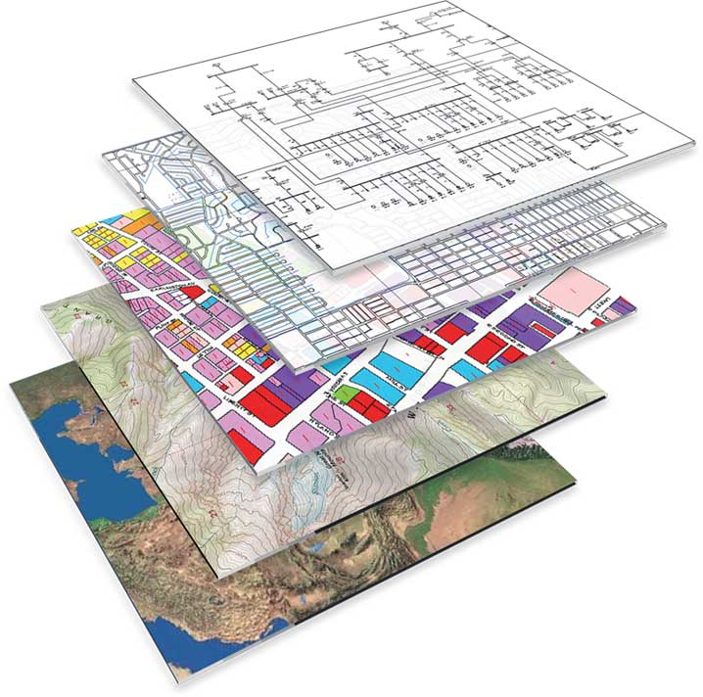
GIS concepts

Slide 11
GIS Concepts
Geographical Information System (GIS) is “A system for capturing, storing, checking, manipulating, analyzing and displaying data which are spatially referenced to the Earth” (A Peter Burrough 1998).

Slide 12
GIS Concepts …. Contd..
GIS data is in the forms of layers which maybe vector or raster layers
In vector data model, features are represented by point, line and polygons.
In raster data model, features are represented by pixel.
The smaller the pixel size the clearer representation of objects on earth

Slide 13
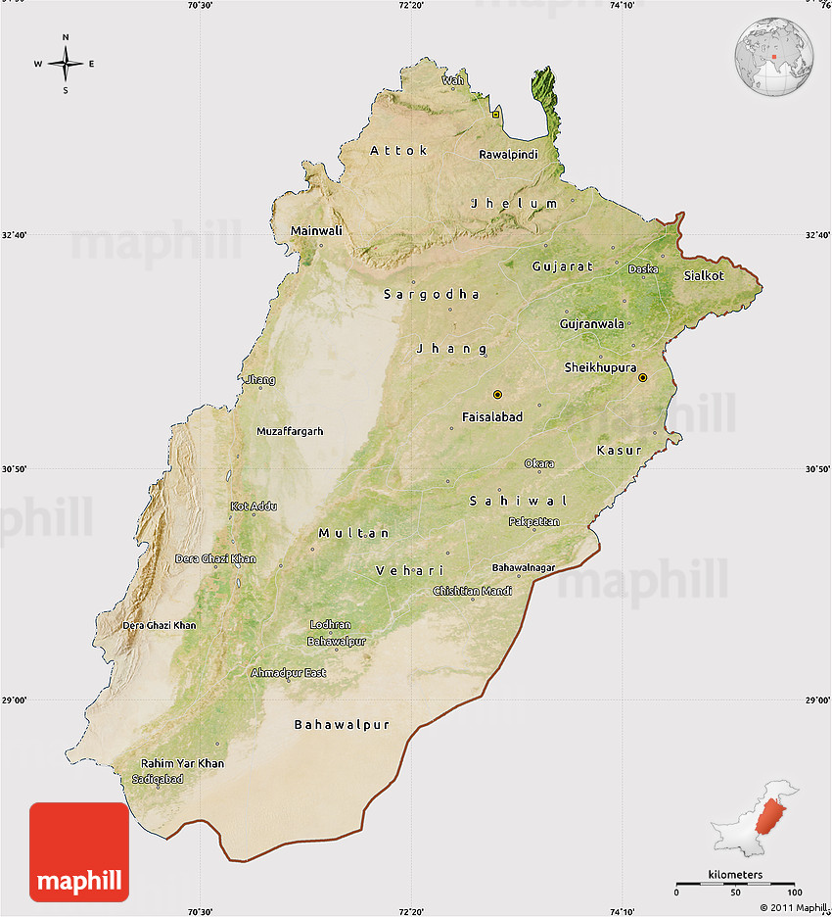
GIS in the punjab

Slide 14
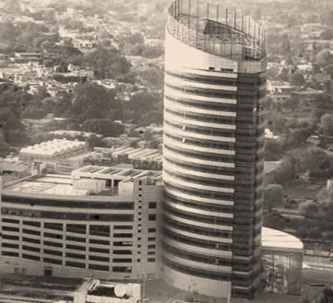
GIS In The Punjab
GIS interventions undertaken by specialized offices, including:
The Punjab Information Technology Board (PITB)
The Punjab Disaster management Authority
Urban Sector Planning & Management Services Unit (Pvt.) Ltd.

Slide 15
GIS In The Punjab…. Contd…
PITB:
An autonomous body under the P & D dept. since 2011
Responsible for undertaking IT projects and acting as the IT service provider.
Important GIS based projects carried out include:
Dengue tracking system (2012)
Till 2017, fifty thousand houses geo-tagged
21 million dengue surveillance activities undertaken
Crime mapping system for Punjab Police
(Source: PITB Interventions & impact report 2017)

Slide 16
GIS In The Punjab…. Contd…
PDMA:
It was estb. in compliance of section 3 sub-section (1) of the NDMA act of 2010
It maintains a GIS enabled control room to monitor floods
Flood disaster management system developed
Analysis of satellite data for compensation disbursement
Flood Emergency Reconstruction and Resilience Project (FERRP)underway using GIS tools

Slide 17
GIS In The Punjab…. Contd…
Urban Unit (Pvt.) Ltd:
Leading GIS development house in Punjab
Projects undertaken include:
Integration of Land Record Management Information System with GIS (2014)
Punjab Rural Roads Program (KPRRP April 2015- June 2017)
Brick Kilns Census Punjab (2016)
Punjab Cities Growth Atlas 1995-2015

Slide 18
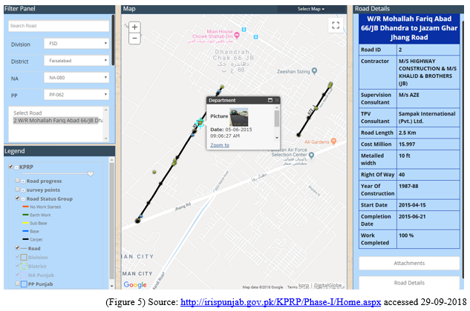
KPRRP

Slide 19
Brick kilns Census

Slide 20
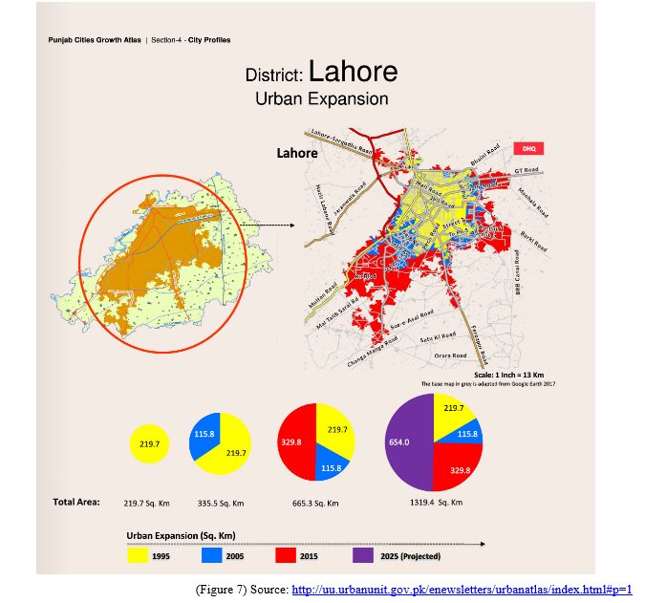
Punjab Cities growth atlas

Slide 21
Analysis of selected GIS projects

Slide 22
Study Of eVACCS Project
Project initiated under World Bank Program PPMRP
Planned IT intervention was for EPI/Child Vaccination
GIS based vaccinator performance program named e-Vaccs was launched in June 2014

Slide 23
eVACCS.. Contd..
The vaccinators given smartphones with eVaccs application installed
The vaccinators would setup their “kit stations”
When the vaccinator would start the e-Vaccs application, his/her geographical location would be automatically stored
For each child a unique record would be saved, along with picture of the child. The name of the child’s parent with CNIC would also be fed in the app.
The type of vaccine given would also be stored
Whenever the vaccinator’s smartphone would connect to the internet, each vaccination activity-record would be sent to the PITB data-center.
At the PITB data-center all the activities of the vaccinators would automatically get reflected on a dashboard.

Slide 24
Study Of eVACCS Project…. Contd…

Slide 25
eVACCS Dashboard Views

Slide 26
eVACCS Outcomes
Attendance of the vaccinators monitored/ensured
By spatially viewing the work of the vaccinators, the actual coverage of vaccination across Punjab was monitored
Child data maintained online
Usage of Vaccine Vials monitored
Vaccinators administered 49.12 million vaccines to 7.65 million children

Slide 27
Vaccinator Activity Analysis (June 2015-June 2016)
No evidence to conclude whether a high percentage of children had been vaccinated in a particular district
Better supervision resulted in better vaccination results

Slide 28
Analysis Of eVACCS Project
The project was implemented in an ad-hoc manner
No baseline demographic information was linked with the spatial areas polygons
There was no empirical evidence to conclude whether a high percentage of children had been vaccinated in a particular district
GIS remained a mere attendance monitory tool
Uniqueness with regards to child data was missing
UC level census data correlated with vaccinated data in polygon may enhance accuracy of data

Slide 29
Computerization Of Urban Immovable Property Tax Phase I
Client: Excise Taxation and Narcotics Control Dept.
Project started in 2013 with Sialkot as pilot
Computerization done for 06 districts including Lahore

Slide 30
Urban Immovable Property Tax System
A manual property tax system was in-vogue
Revenue targets remained low due to ad-hoc methods of property tax evaluation
Lack of transparency as no system methods were available to supervise and evaluate the property taxation activity
Due to lack of supervision there were wide spread public grievances’ inducing a culture of property tax evasion

Slide 31
Urban Immovable Property Tax System
Urban unit carried out following activities:
All the existing manual record available in forms PT-1, PT-8 and PT-10 was scanned
The scanned data was typed into a specially designed Excise and Taxation record database
New digital form for recording the PT-1 information was made
Satellite imagery was used for parcel mapping of urban areas

Slide 33
Urban Immovable Property Tax System
All properties within tax zones were turned into unique parcels using GIS tools
Each digital spatial property on the digital map of the district had a unique 28-digit PIN code
The taxation data was linked in the with the spatial property PIN codes

Slide 34
PIN Codes assigned to Parcels
Source : Book Chapter Urban Unit

Slide 35
Urban Immovable Property Tax System
Comprehensive survey of all properties in the cities for their geo-tagging
A dashboard was prepared to view the urban property system online

Slide 36
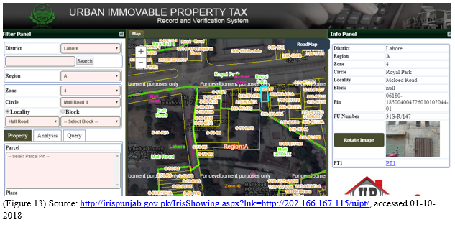

Slide 37
Project Outcomes
Business process re-engineering done to replace manual system with IT solution
The department could now plan its taxation targets on evidence basis rather than on manual estimates
0.498 million new properties identified
Classification of properties on value categories was done
Real-time supervision of staff was made possible
(Source: Book chapter on UIPT project by Urban Unit)

Slide 38
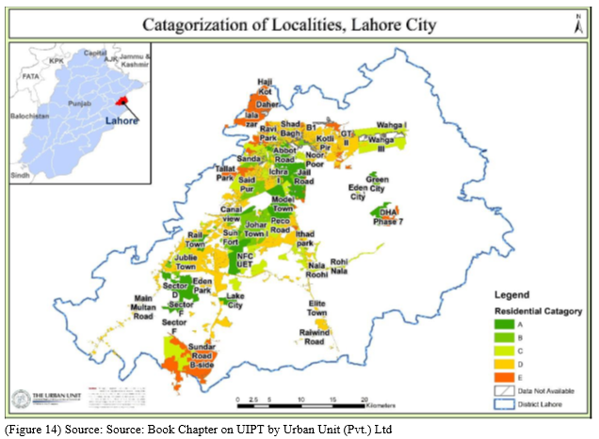

Slide 39
Analysis Of Project
Maps were not certified by any competent forum
Data converted from manual to digital form was not “digitally” signed off / approved by the Excise and Taxation Dept.
Lack of capacity of Departmental staff was a sustainability issue
System and database kept with urban unit instead of Excise dept.
Parcel dimensions did not reflect actual area of source location

Slide 40
Overall Critical Review of GIS implementation

Slide 41
Critical Review
Ad-hoc approach to GIS development followed
GIS deployed as mere location tracking tool
Most GIS interventions were city centric
Change management aspect not given due consideration
Parent offices had week GIS skill

Slide 42
Critical Review… Contd…
Standard approach to software development was not followed
Detail requirement analysis not done
GIS attributes only added on “as you learn along the way” basis
Loads of redundant and incompatible spatial data being populated by different public offices
No spatial data infrastructure (SDI) for the Punjab

Slide 43
Conclusion

Slide 44
Conclusion
The government of Punjab is gradually adopting GIS solutions for
modernizing the working of various departments,
introducing real-time supervision and
enhancing operational transparency in the public sector
The GIS development has largely been urban oriented
Great scope remains for further development is other areas.
A myopic/ ad-hoc approach to GIS implementation carry the risk of GIS technology not being used to its full potential
and also being suspect to sustainability issues.

Slide 45
Recommendations
A SDI may be developed for the province of the Punjab
GIS interventions may be considered as full “business process models”, rather than mere tracking and graphic tools
GIS interventions may be utilized more for rural landscape projects, environmental initiatives and in agriculture and forestry domains

Slide 46
Recommendations … Contd..
Ownership for the new spatial information should be established in the public offices
Periodic exercise on change management may be carried out
In-depth sectoral research may be carried out on the specific need assessment of GIS interventions

Slide 47
Thank you!

